Slide 1
Physics for Scientists and Engineers
Paul A. Tipler • Gene Mosca
Fifth Edition
Chapter 41:
Elementary Particles and the
Beginning of the Universe
Copyright © 2004 by W. H. Freeman & Company

Slide 2
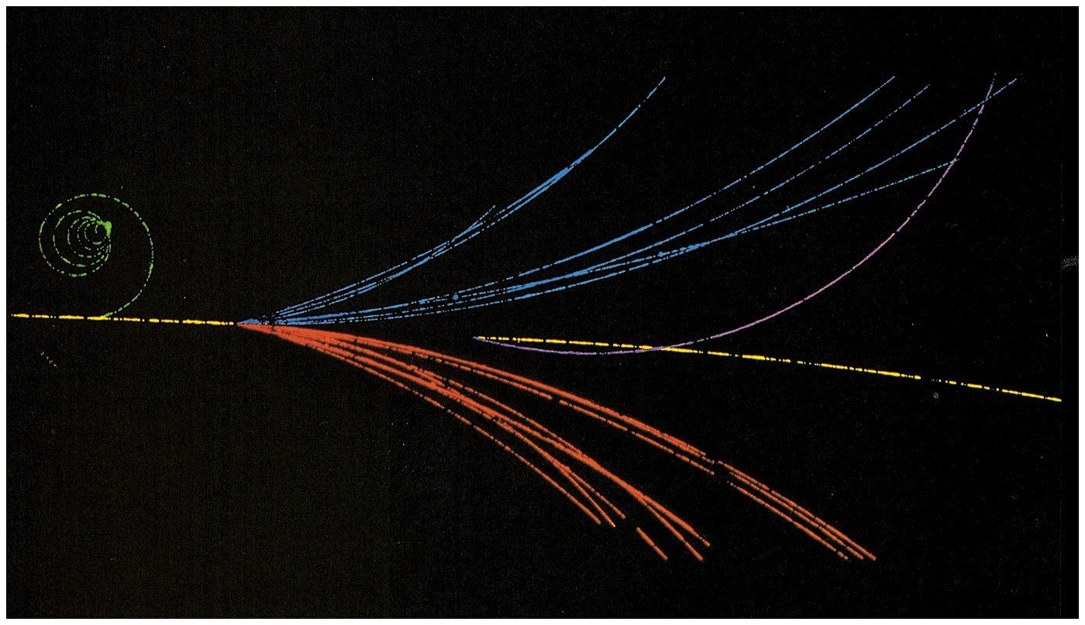

Slide 3
41-1
Hadrons and Leptons

Slide 4
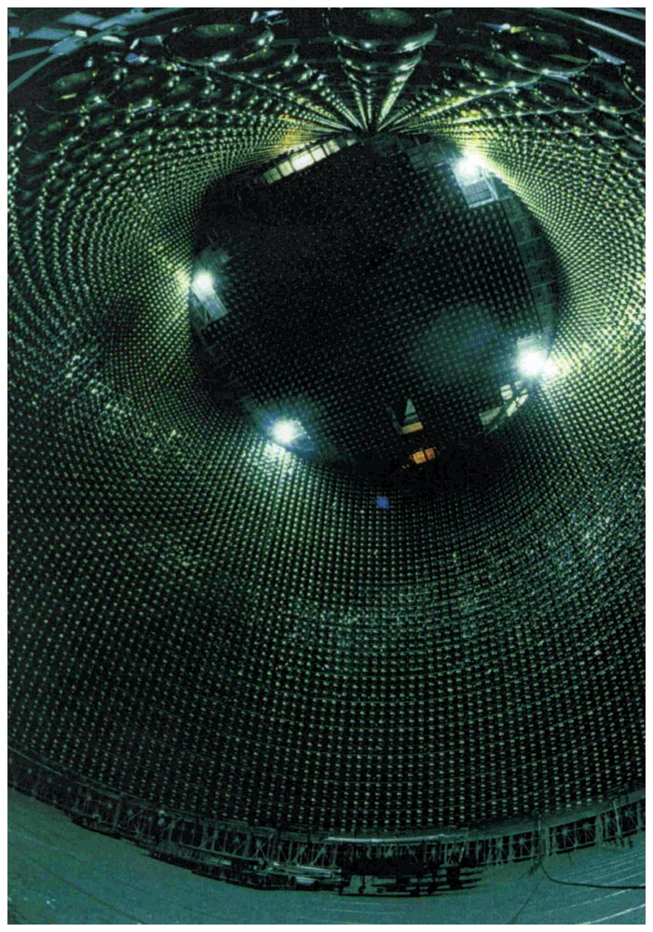

Slide 5
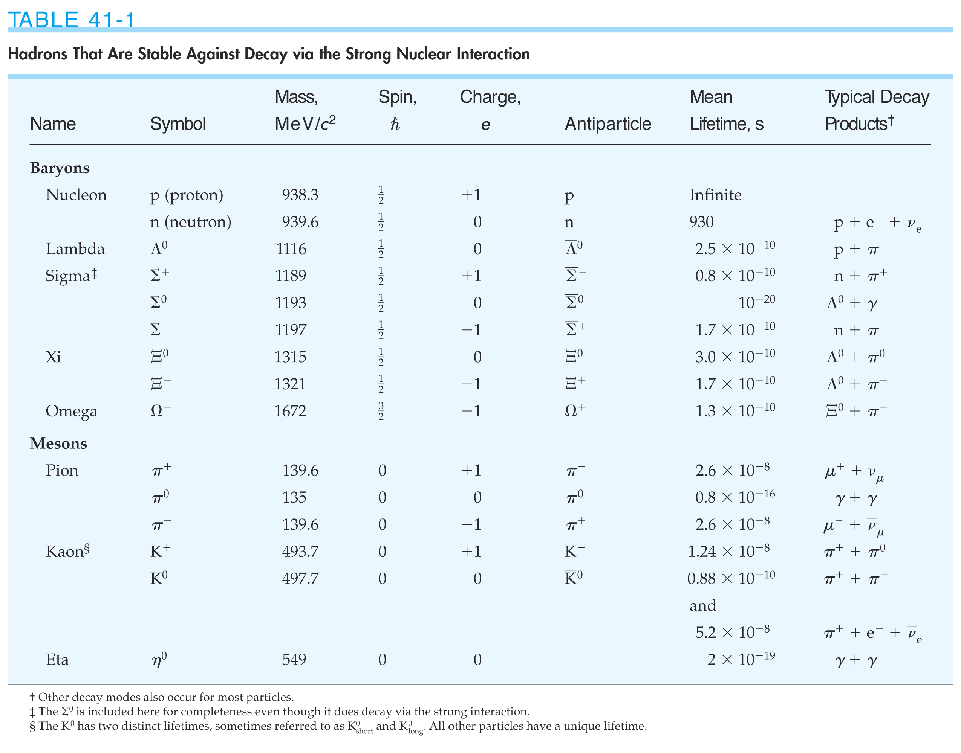

Slide 6
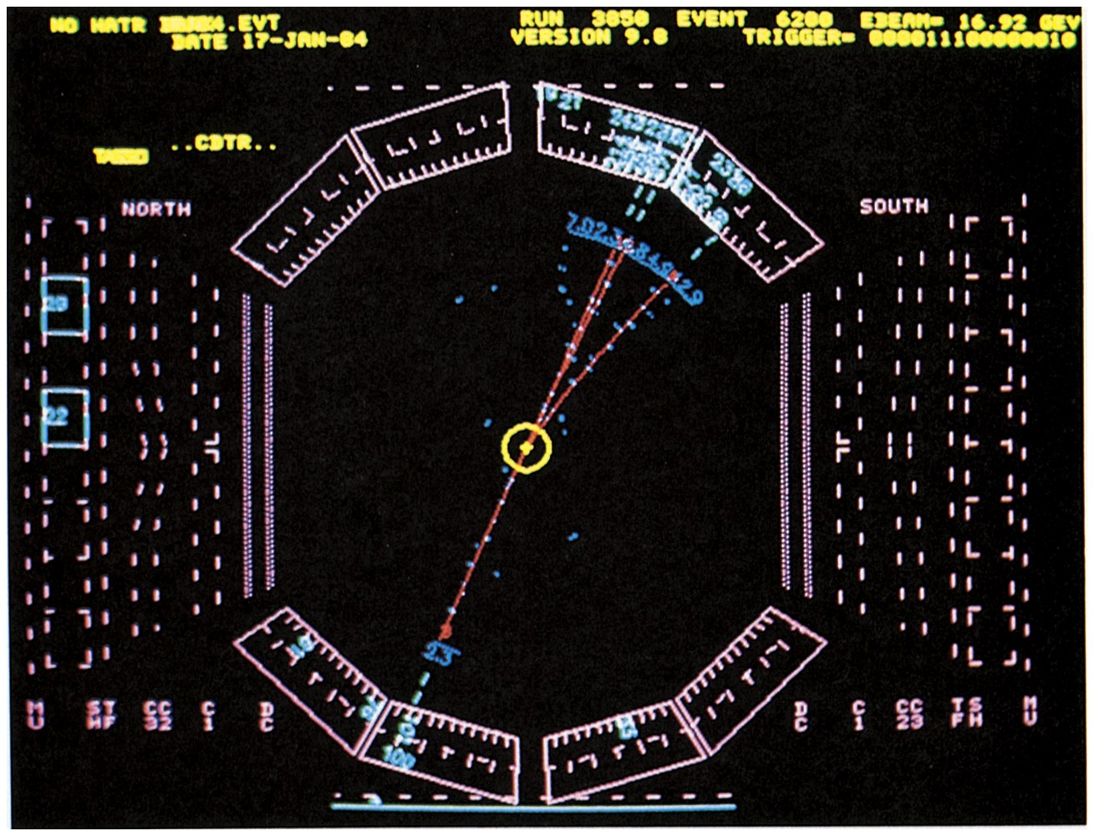

Slide 7
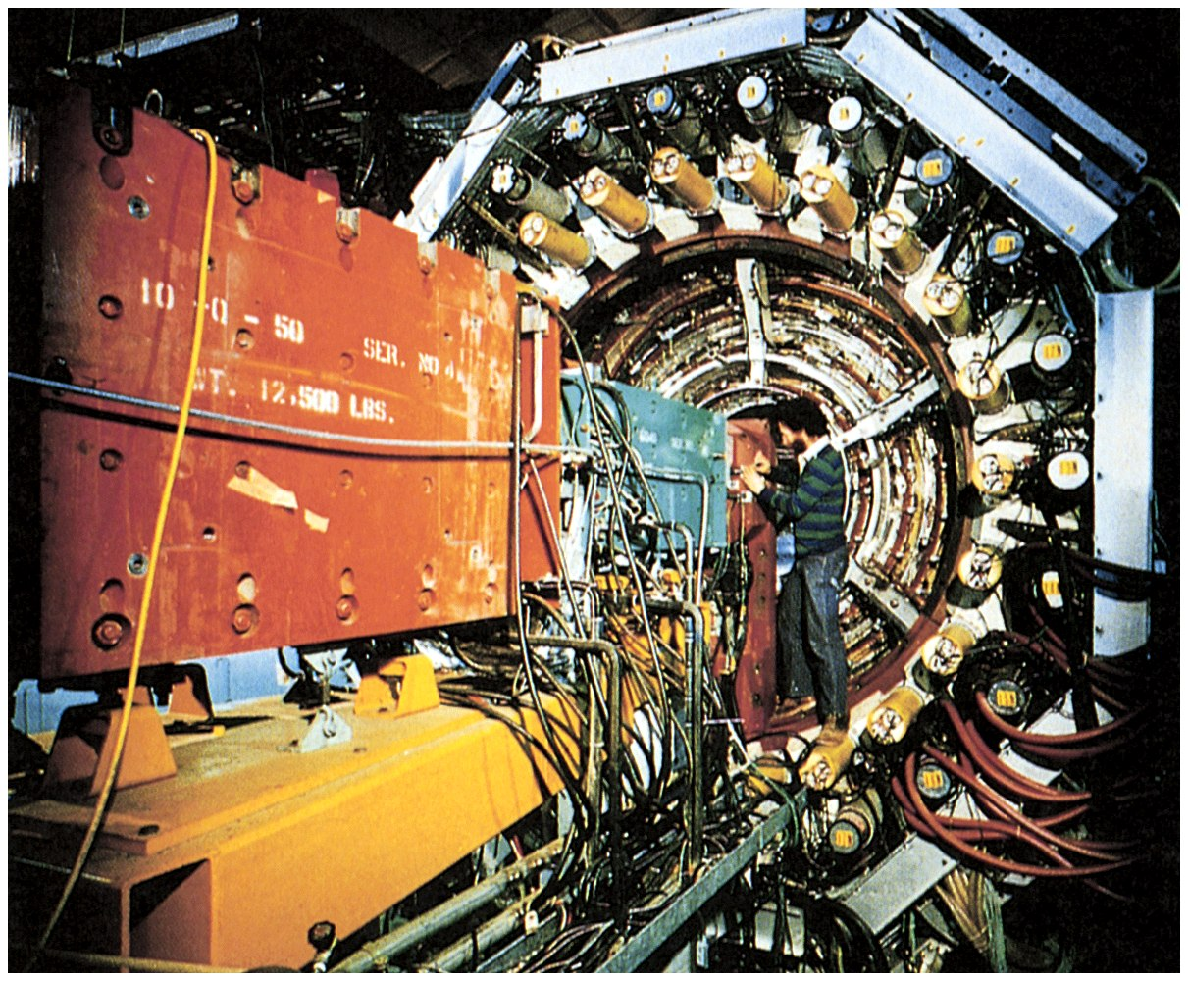

Slide 8
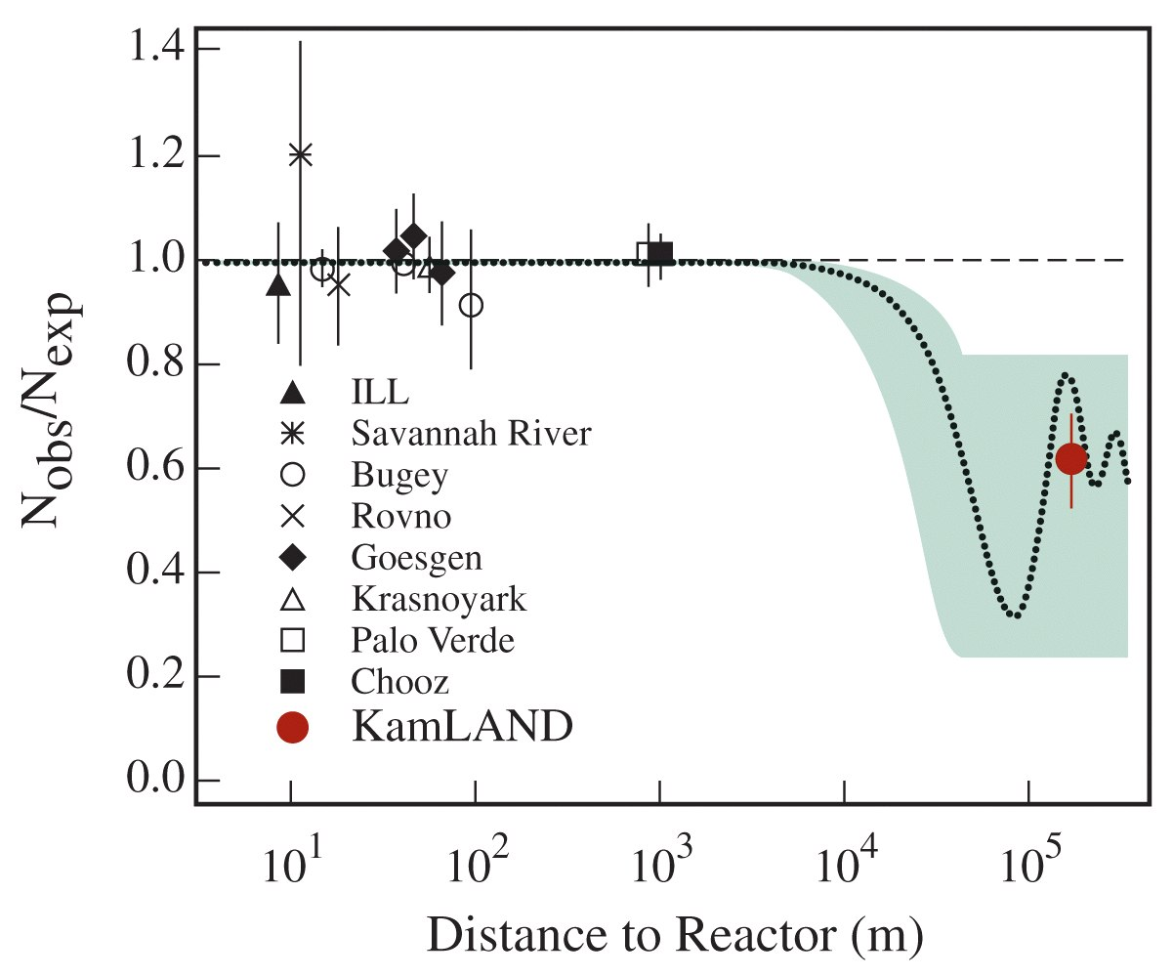

Slide 9
41-2
Spin and Antiparticles

Slide 10
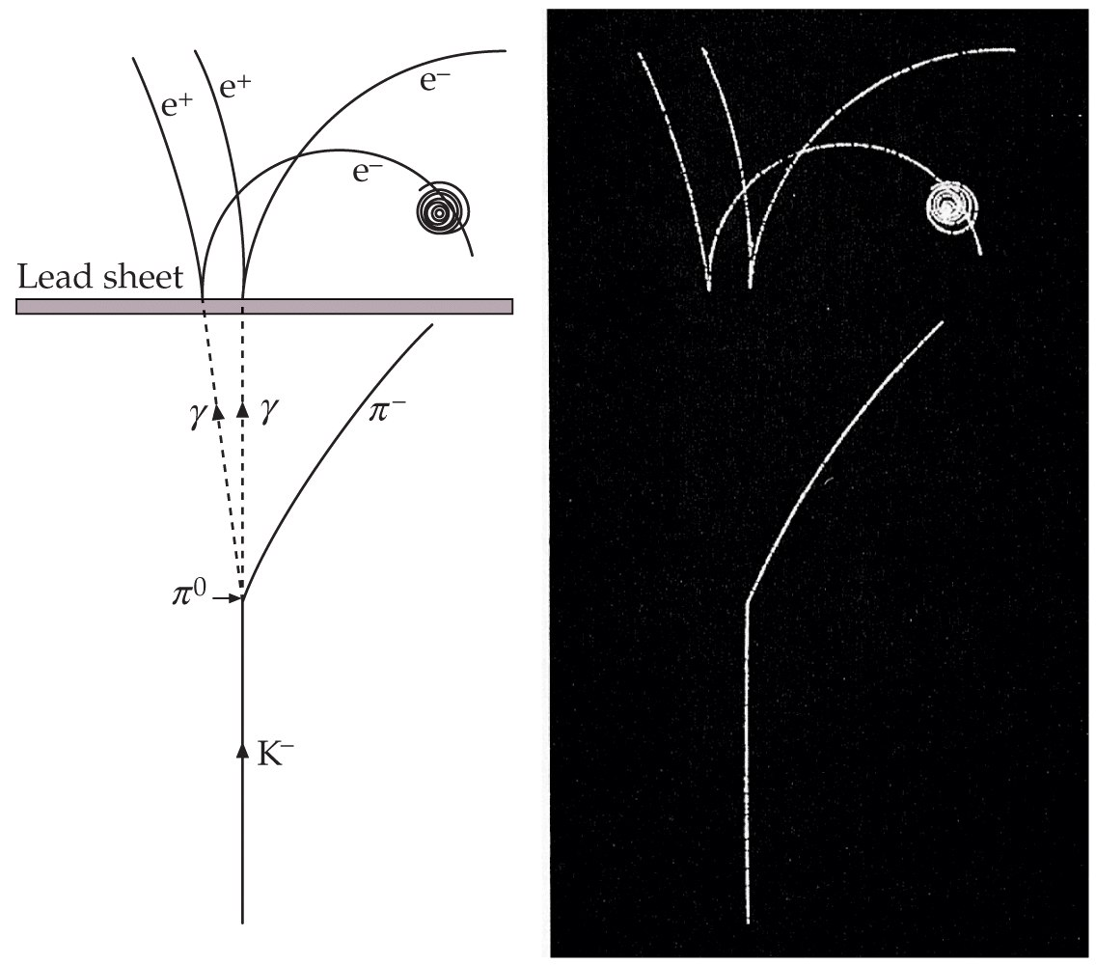

Slide 11
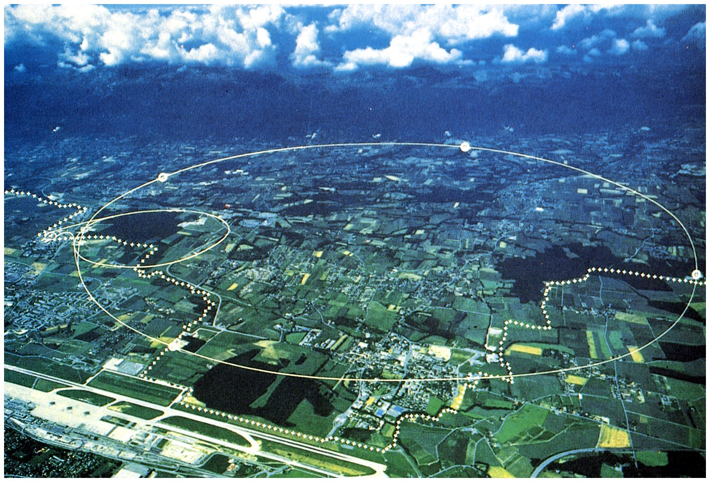

Slide 12
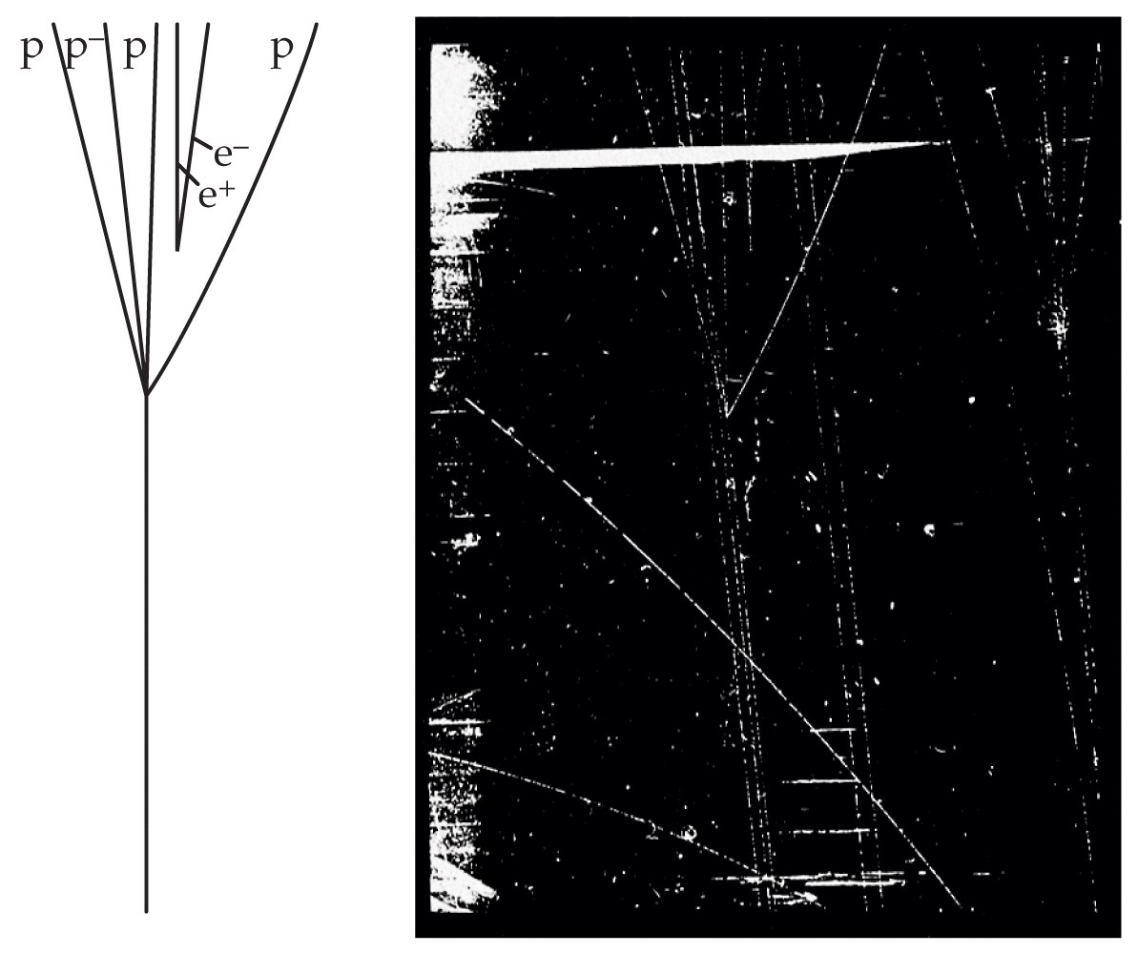

Slide 13
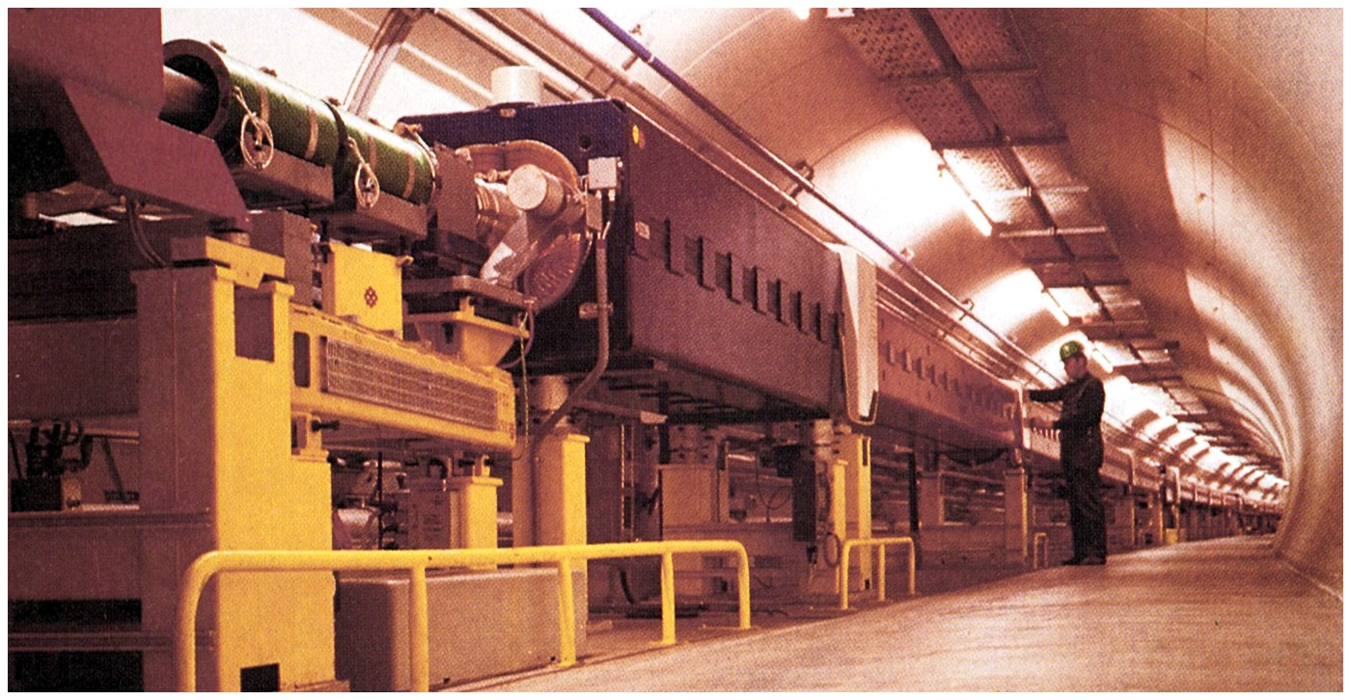

Slide 14
41-3
The Conservation Laws

Slide 15
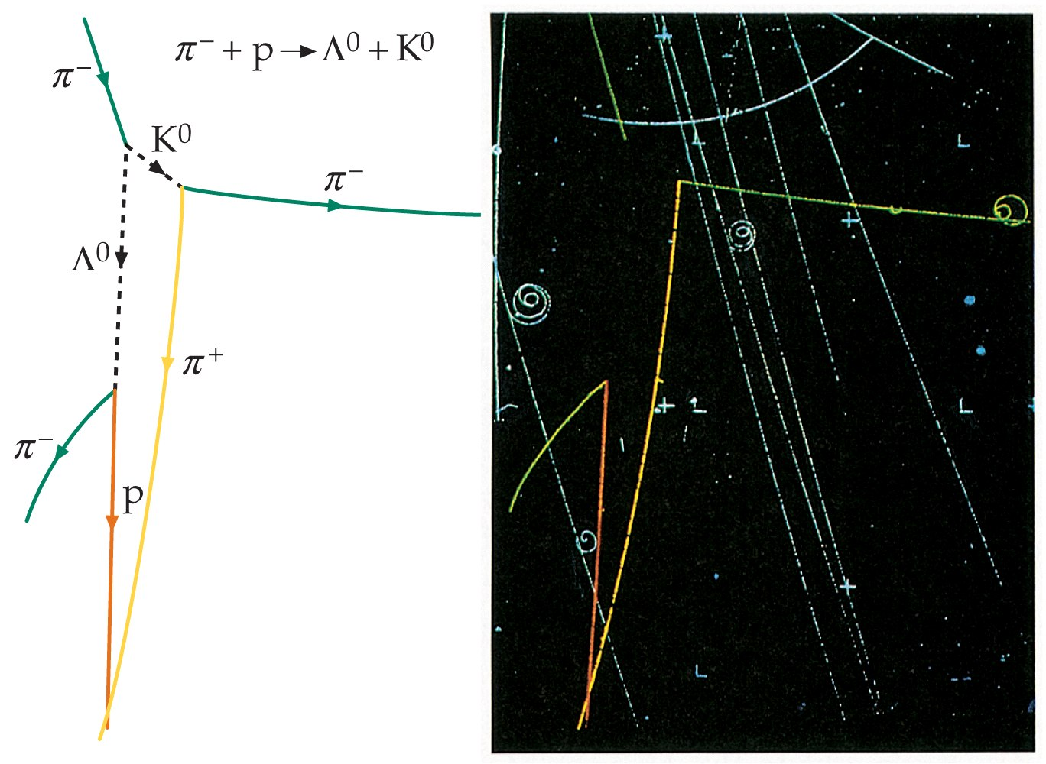

Slide 16
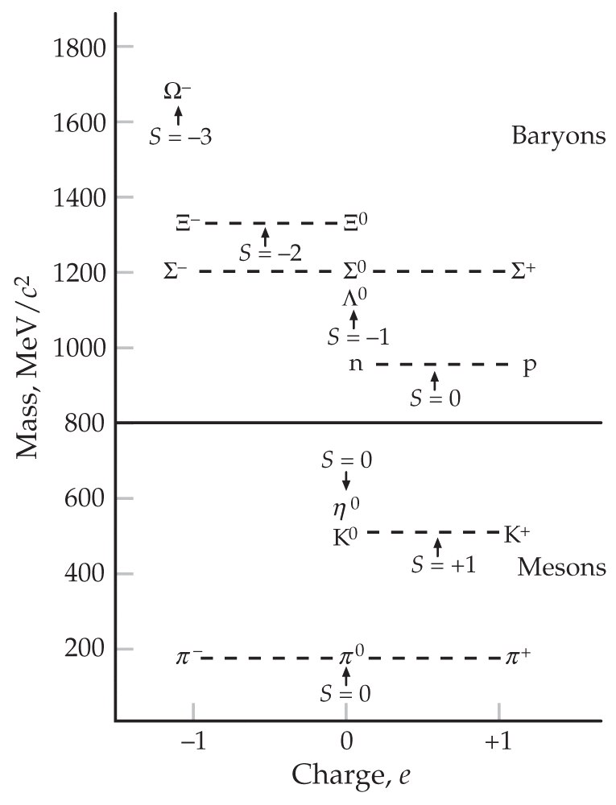

Slide 17
41-4
Quarks

Slide 18
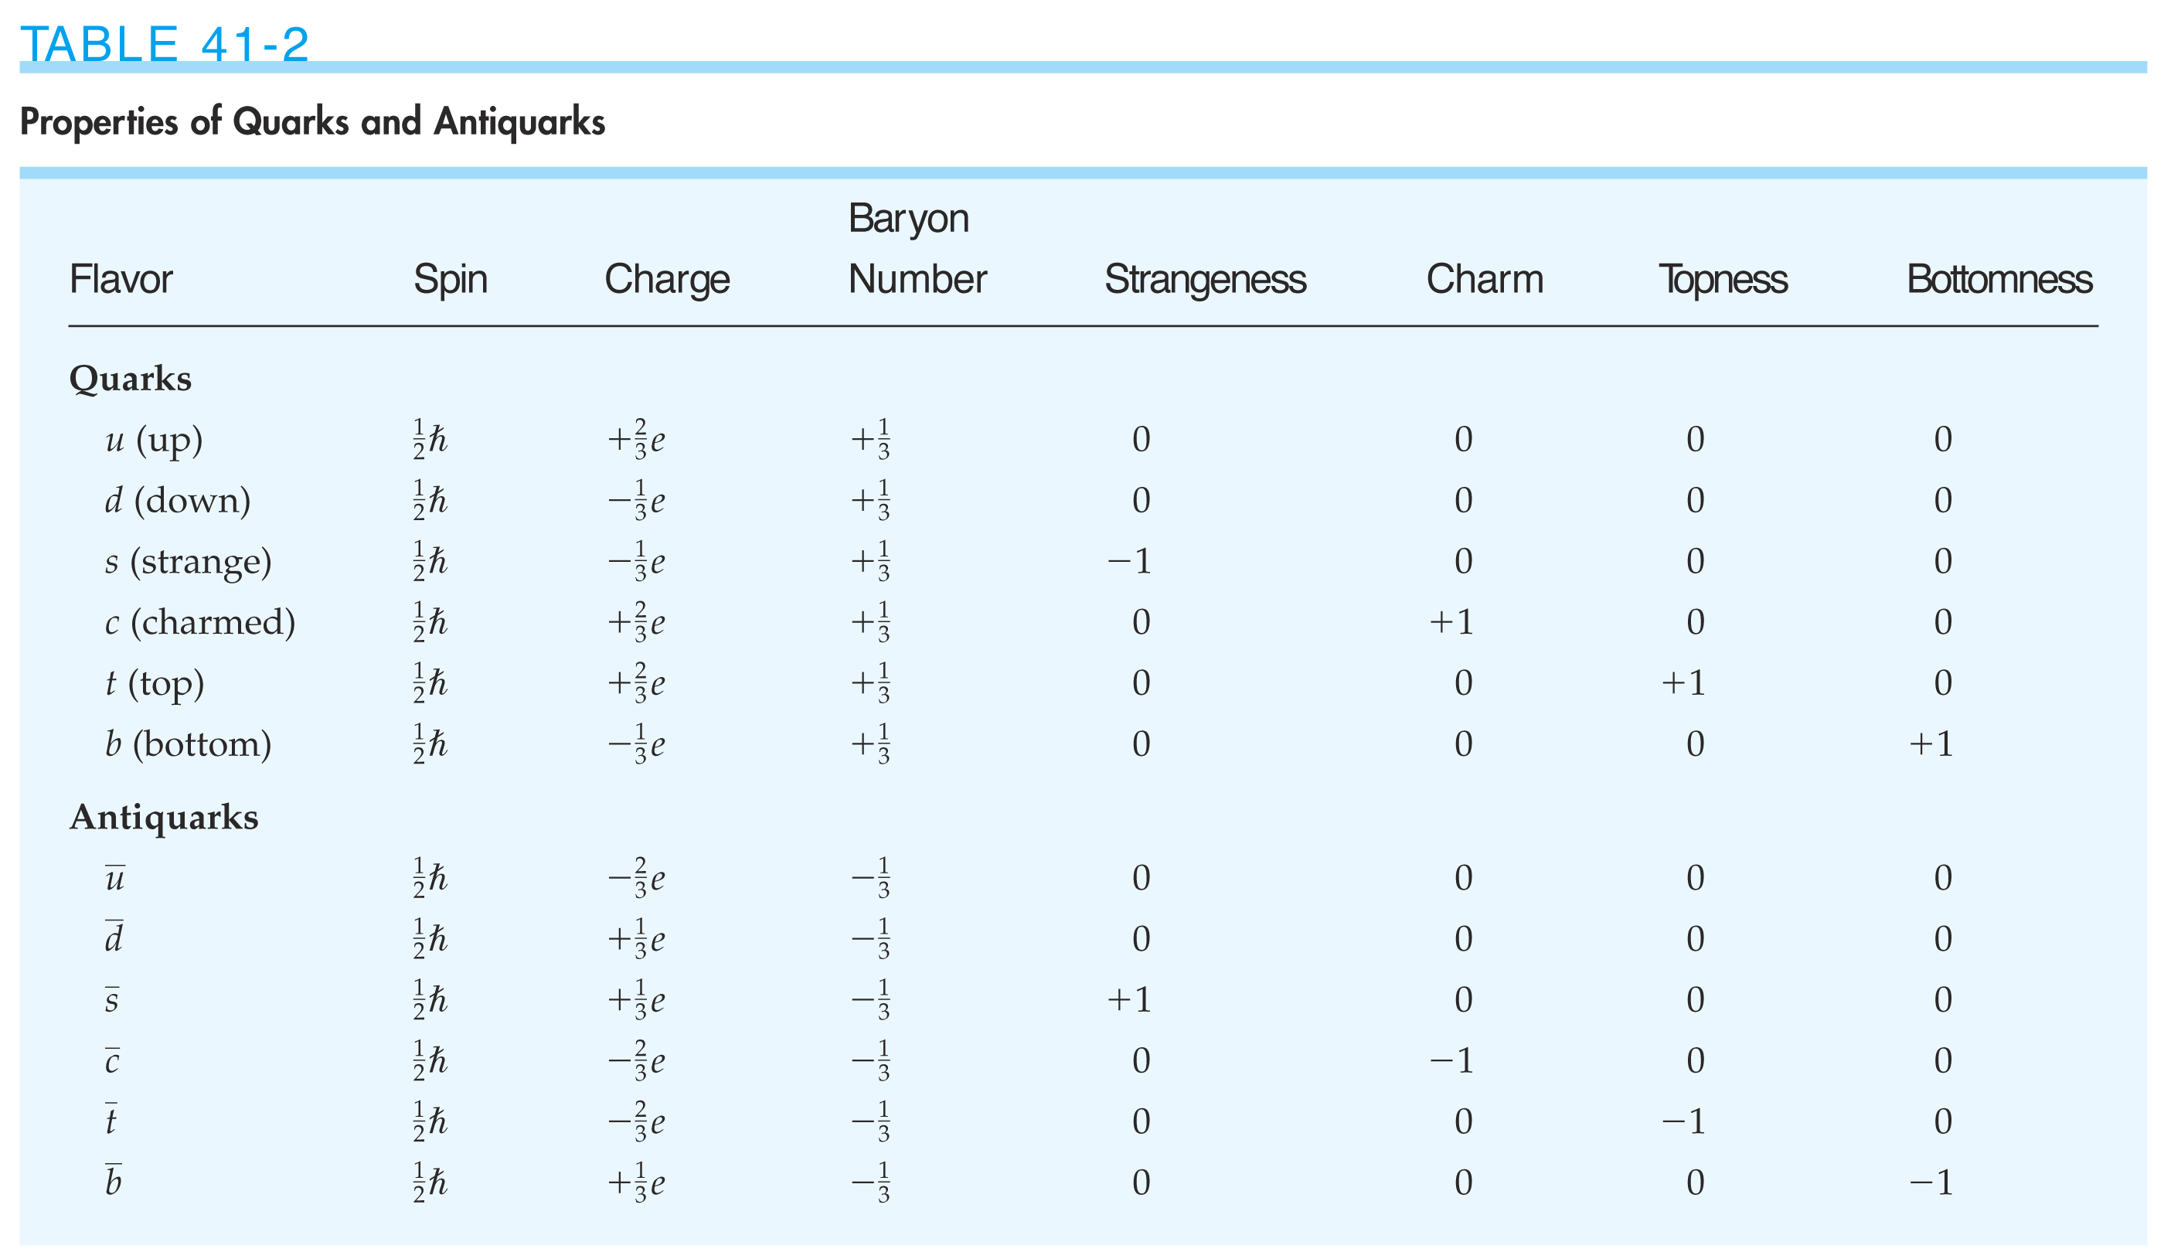

Slide 19
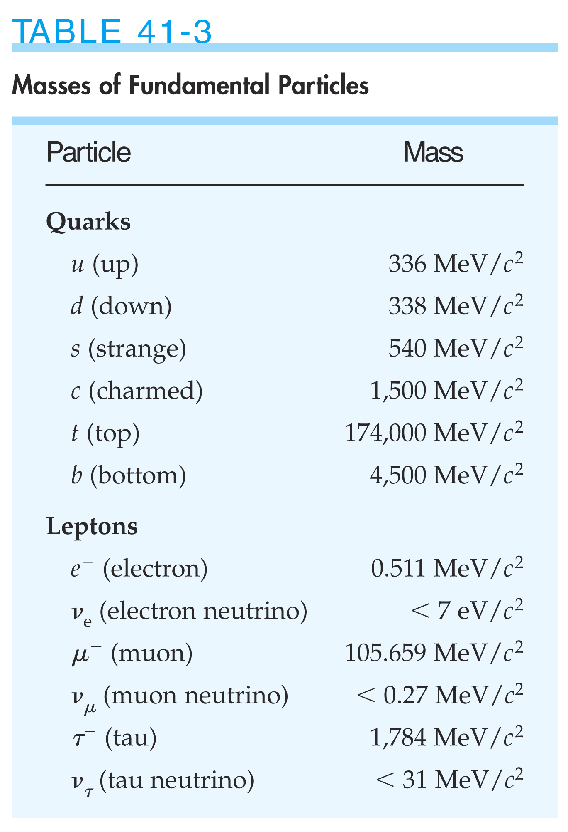

Slide 20
41-5
Field Particles

Slide 21
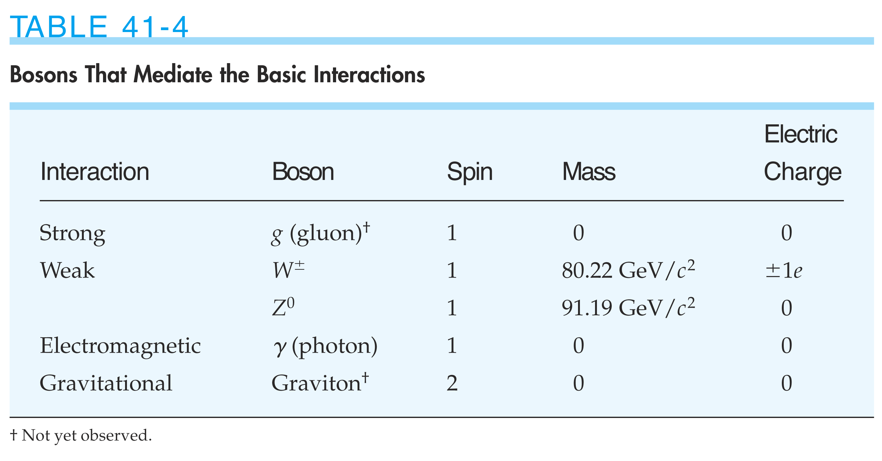

Slide 22
41-6
The Electroweak Theory

Slide 23
41-7
The Standard Model

Slide 24
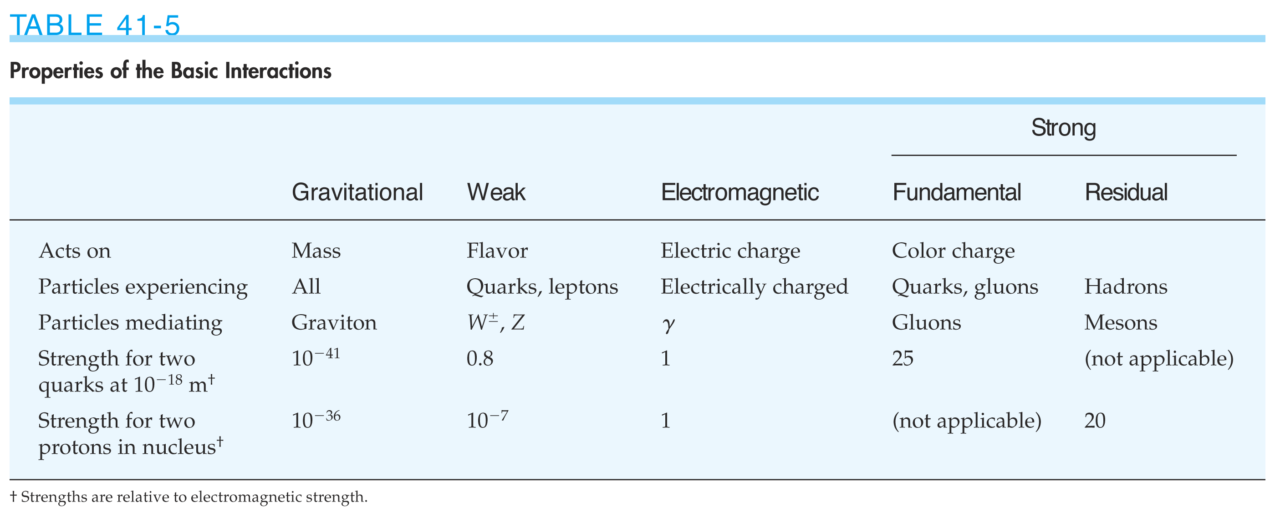

Slide 25
41-8
The Evolution of the Universe

Slide 26
